Slide 1
Flower Dataset
Capstone Project
By Jeremy Improgo

Slide 2
Introduction/Problem Statement
There are numerous flower species and identifying them can be difficult
Objective:
Create a predictive tool that can identify and classify certain flowers

Slide 3
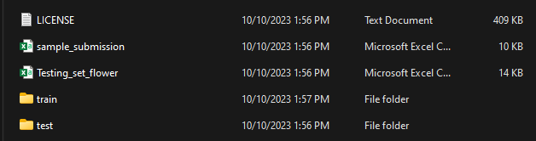
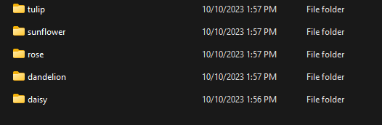
Dataset Details
JPG image format
Each class contains around 500 images
Images vary in size
5 distinct classes of flowers

Slide 4
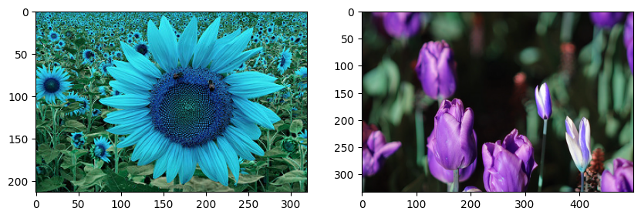
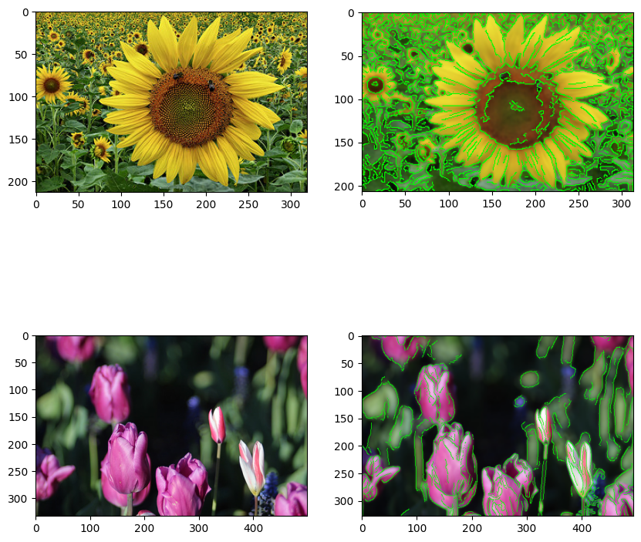
EDA (Exploratory Data Analysis)
Compared images from top 2 classes

Slide 5
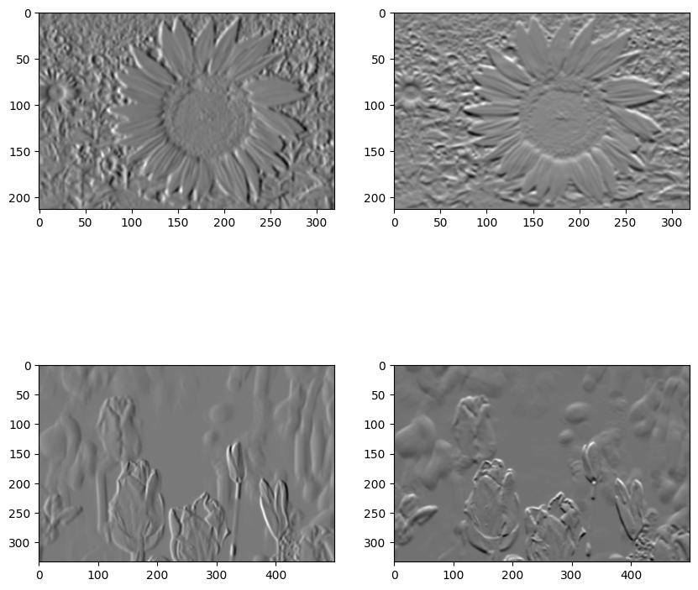
EDA
Edge Detection

Slide 6
EDA
Canny Edge Detection

Slide 7

PDA (Predictive Data Analysis)
Teachable Machine was used
Provides keras tensorflow code

Slide 8
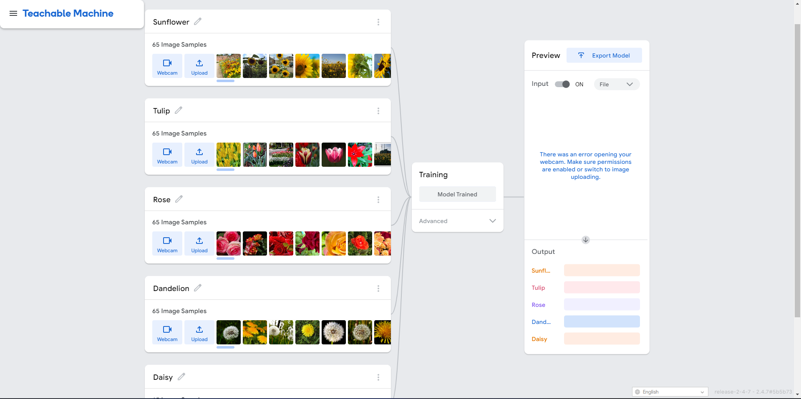

Slide 9
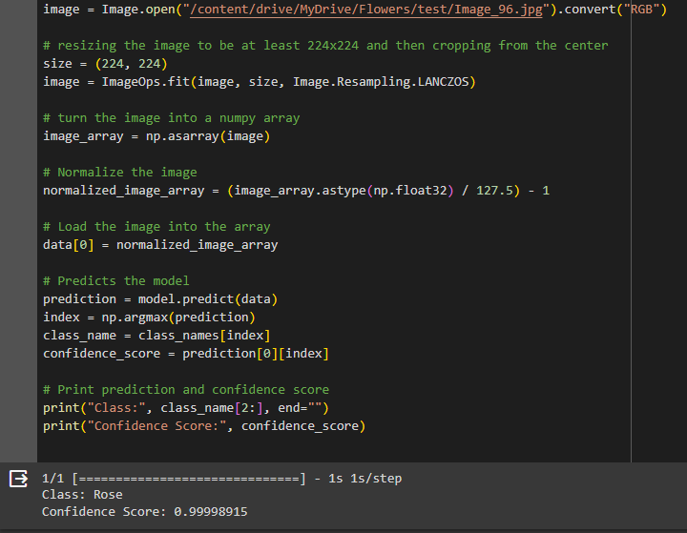


Slide 10
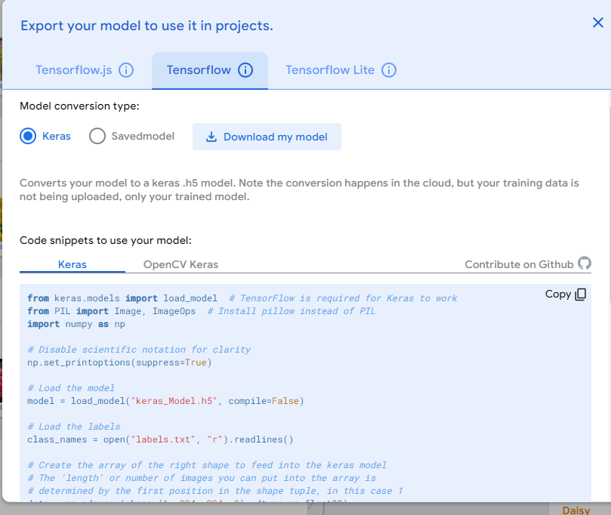
Implementation and Deployment
Currently in development
Uses the Tensorflow Keras package
Will be put into a GUI
User can upload an image

